Slide 1
NYC 2019 Crime Trends Analysis
Leo Cohen-Gussack – Data Cleansing / Transformation
Pongyin Hui – Data Cleansing / Transformation
Cynthia Rojas – Mapping / Plotting
Joann Lin – Calculations / Analysis

Slide 2
Proposal / Hypothesis
Analyze crime data in the five boroughs of NYC (Queens, Brooklyn, Manhattan, Bronx, Staten Island)
Data sets used:
NYPD Complaint Data
Wi-Fi Hotspot Locations
NYC Mobile Telecomm (includes streetlights data)
HYPOTHESIS We expect there to be a positive correlation between crime and foot traffic (the further from a streetlight / wifi hotspot location the more likely for a crime to occur)

Slide 3
Data Cleansing & Transformation
Data Cleansing:
Dropped empty cells for latitude & longitude
Changed format of data (e.g. dateparse)
Data Transformation:
Specified if the crime occurred during the day or night
6:00am - 6:00pm - day time
6:01pm - 5:59am - night time
Filtering:
By borough
2019

Slide 4
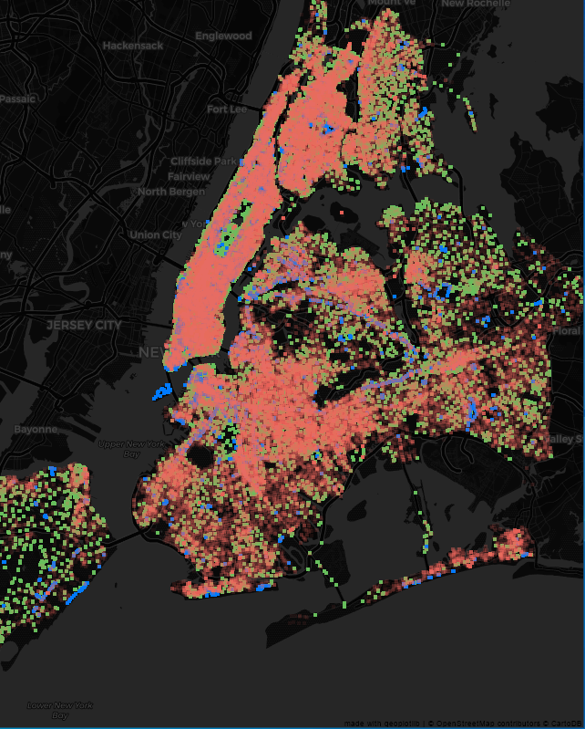
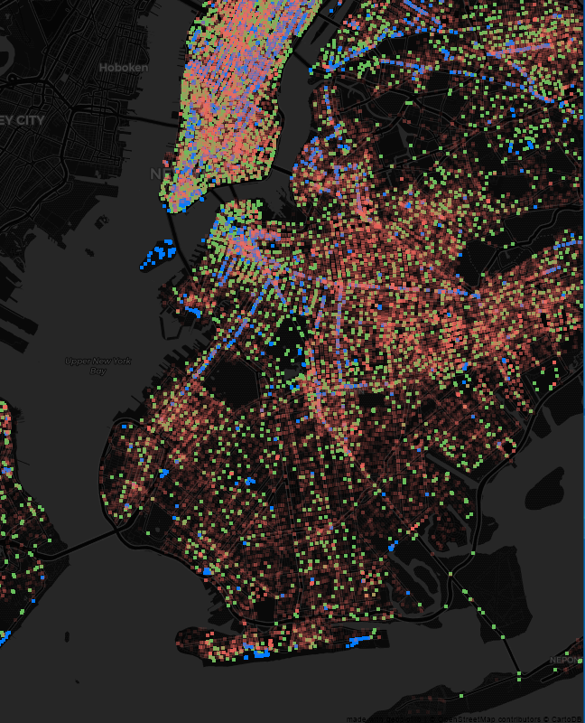
Mapping / Plotting
Streetlight , wifi, crime occurrences
Tools used –
Alpha
Darkmatter
Library used –
Import geoplotlib as gp

Slide 5
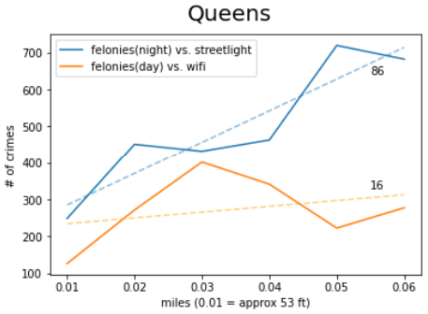
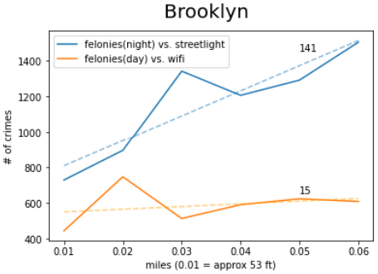
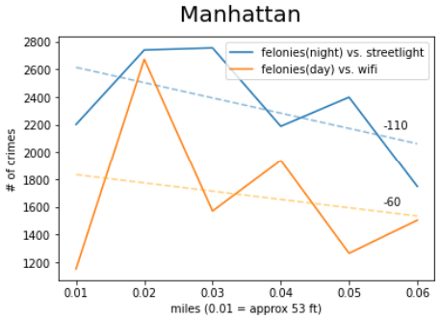
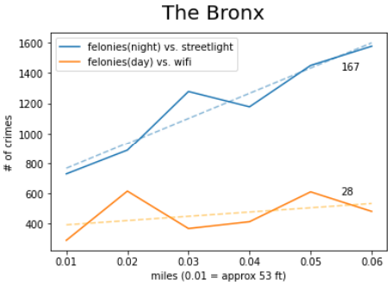
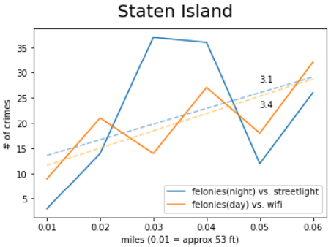
Calculations / Analysis
HIGHLIGHTS OF OUR FINDINGS
Clear correlation between streetlights and crime rate
Mostly positive correlation between wifi and crime rate
Manhattan has negative correlation
All boroughs have strong positive correlation in first 106 ft

Slide 6
Conclusion
Summary of Findings:
More crimes occur at night vs. during the day
Brooklyn and The Bronx have very similar crime rates
Manhattan has the highest rate of crime
Mostly very clear positive correlation between streetlights and crime rate
Mostly positive correlation between wifi and crime rate, although a lot weaker correlation than streetlights
Manhattan is the only borough where there is a negative correlation between streetlights / wifi and crime rate
Within a perimeter of approx 0.2 miles (~106 ft), there is a very strong correlation between streetlight / wifi and crime rate (for all boroughs)
HYPOTHESIS We expect there to be a positive correlation between crime and foot traffic (the further from a streetlight / wifi hotspot location the more likely for a crime to occur)

